Slide 1
Mobile Application Development

Slide 2
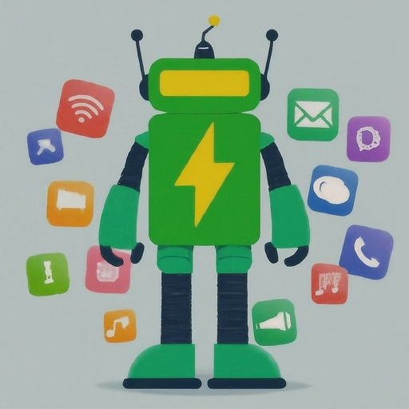
Welcome to Android Full Stack Development & Git Version Control

Slide 3

What is Android Full Stack Development?
Full stack development involves handling both the frontend (user interface) and backend (data management) aspects of an application.
In Android development, full stack developers can:
Design and build engaging user interfaces with Kotlin or Java.
Develop server-side logic using languages like Java, Kotlin, or Python.
Work with APIs and databases to store and retrieve data.

Slide 4
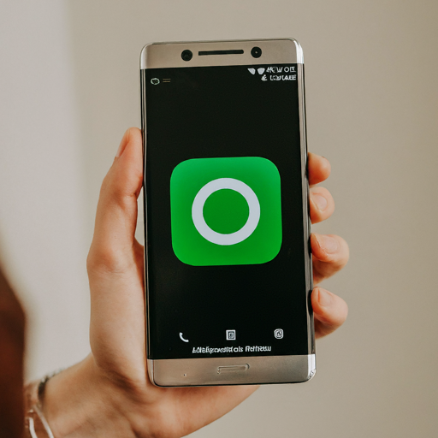
Front-End Development
Key technologies for building the app's interface:
Kotlin or Java: Programming languages for creating the app's logic and structure.
XML: Defines the layout and visual elements of the app.
Android Studio: The official integrated development environment (IDE) for building Android apps.

Slide 5

Back-End Development
Handles data storage, retrieval, and server-side logic:
Languages like Java, Kotlin, or Python: Power the server-side processing and interactions with databases.
APIs: Define how apps communicate with server-side components.
Databases: Store and manage app data like user information, settings, and content.

Slide 6
Benefits of Full Stack Development
Deeper understanding of the entire development process.
Ability to handle all aspects of app development independently.
Increased efficiency and faster development cycles.
Improved problem-solving skills and adaptability.

Slide 7
APP CONCEPT
Listen&Learn is a revolutionary mobile application that empowers students to study smarter, not harder. Using advanced text-to-speech technology and universal document support, Listen&Learn transforms any text into an immersive audio experience, catering to diverse learning styles and abilities.

Slide 8
App Concept: Target Audience
Students of all ages and backgrounds: Listen&Learn benefits everyone from high schoolers cramming for exams to university students tackling complex texts.
Learners with visual impairments or reading difficulties: Listen&Learn removes reading barriers, promoting inclusivity and equal access to information.
Busy professionals: Listen&Learn allows efficient learning on the go, turning commute times into productive study sessions.

Slide 9
App Concept: Key Features
Universal document support: PDFs, eBooks, web articles, notes – Listen&Learn seamlessly converts any text format into audio.
Advanced text-to-speech: Choose from diverse voices, accents, and speeds to personalize your learning experience.
Active listening tools: Annotate, highlight, and take notes while listening to enhance comprehension and retention.
Smart study modes: Create custom playlists, set timers, and track progress to stay focused and motivated.
Collaborative learning: Share notes and study materials with friends and classmates for a more engaging learning experience.

Slide 10
App Concept : Competitive Advantage
Listen&Learn goes beyond basic text-to-speech, offering a comprehensive suite of study tools and universal document support.
Its focus on accessibility and inclusivity sets it apart from other apps, catering to a wider range of learners.
The intuitive interface and personalized features make studying with Listen&Learn a seamless and enjoyable experience.

Slide 11
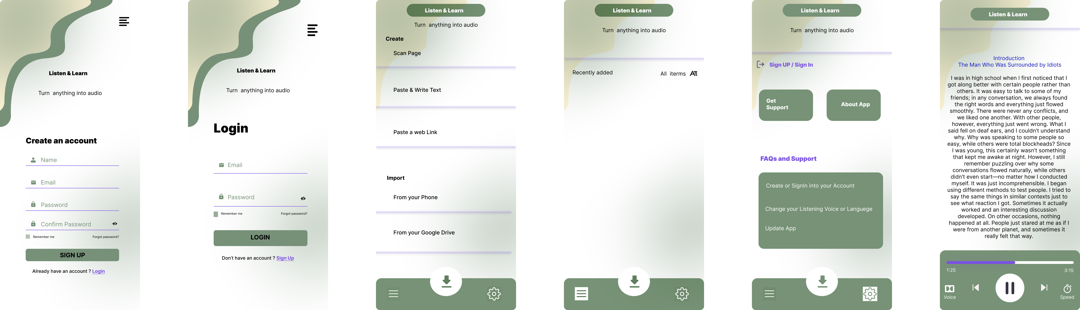
Application Prototype

Slide 12
Git: Version Control
Git is a distributed version control system (DVCS), meaning each developer has a complete copy of the codebase.
It tracks changes made to your code over time, creating snapshots called commits.
Think of it as a time machine for your code, allowing you to revert to previous versions if needed.
Popular platforms like GitHub and GitLab help you store and collaborate on your Git repositories.

